Slide 1


DBMS WITH MINI PROJECT REPORT PRESENTATION ON COLLEGE PLACEMENT MANAGEMENT SYSTEM
Under the guidance of
Mrs. Ayesha Noorain
Dept. of AIML
KNSIT
Presented by
P GANESH - (1KN21AI029)
PRABHAT PRASAD SHAH - (1KN21AI030)
PUNITH KUMAR M - (1KN21AI032)
PRIYA B - (1KN21AI031)

Slide 2
Contents
Abstract
Introduction
About python & MYSQL
Literature Survey
ERD (Entity Relationship Diagram)
Schema Diagram
Libraries Used
Database Connection
Add Student Functionality
Search Student Functionality
Delete Student Functionality
Update Student Functionality
Display Student Functionality
Exit Student Functionality
User Interface Overview
Output
Conclusion
References

Slide 3
Abstract
The College Placement System is a comprehensive solution designed to streamline the management of student records within educational institutions. Developed using Python and the tkinter library for graphical user interface (GUI) design, this system offers a robust set of features to administrators, faculty, and staff.
Central to its functionality is the seamless integration with a MySQL database, facilitated by the pymysql library. This ensures efficient data storage and retrieval, enabling quick access to student information and facilitating timely decision-making processes.
Furthermore, the College Placement System prioritizes data integrity and security, implementing measures to safeguard sensitive information and prevent unauthorized access.
Overall, the College Placement System represents a powerful tool for educational institutions seeking to streamline their administrative processes and enhance the management of student data. Its user-friendly interface, coupled with robust functionality and database integration, makes it a valuable asset for colleges and universities aiming to optimize their placement processes and improve overall efficiency.
Dept. of AIML KNSIT

Slide 4
Introduction
Streamlined Management: The College Placement Management System serves as a centralized platform for educational institutions to efficiently handle the complexities of student placement data, ensuring smoother processes for both administrators and students.
Technological Foundation: Developed with Python for its versatility and MySQL for its robust database management capabilities, the system offers a sturdy foundation for storing, organizing, and retrieving vast amounts of placement-related information securely.
Comprehensive Functionality: Offering a suite of functionalities including data entry, search, update, and deletion, the system empowers administrators with the tools needed to effectively manage student records throughout their placement journey.
Enhanced Operational Efficiency: By automating routine tasks and providing insightful data visualization tools, the system not only improves operational efficiency but also enables institutions to make data-driven decisions, ultimately fostering better placement outcomes for students.
Dept. of AIML KNSIT

Slide 5

About Python
It is a high-level language
Easy to understand like an English
General-purpose
Interpreted
Dynamic
Dept. of AIML KNSIT

Slide 6

About MySQL
Relational Database Management System (RDBMS): MySQL is a popular RDBMS known for its efficiency and high reliability in managing structured data.
Versatility in Applications: It is widely used for tasks such as storing and retrieving data for websites, web applications, and software solutions.
Automation and Scripting: MySQL facilitates automation of repetitive database tasks and scripting through support for stored procedures, triggers, and scheduled events.
Accessibility and Non-Programmer Use: Its user-friendly interface and accessibility make it suitable for non-programmers, including accountants and analysts, for organizing and analyzing data, particularly in financial contexts.
Dept. of AIML KNSIT

Slide 7
Literature Survey
A literature survey for the College Placement Management System provides an overview of existing research, technologies, and systems related to college placement and student information management. Some surveys are:
College Placement Systems ^{[5]} :
College placement systems have become essential tools for educational institutions to manage and streamline the placement process efficiently. Various research studies have explored the challenges faced by colleges in managing student placement data and have highlighted the significance of automated systems in enhancing this process.
Dept. of AIML KNSIT

Slide 8
Literature Survey
Challenges in College Placement Management ^{[6]} :
The challenges faced by educational institutions in managing placement processes have been identified and analyzed. These challenges range from data entry errors to the need for real-time updates. Solutions proposed in the literature include the implementation of automated systems and the use of advanced technologies.
Future Trends and Technologies ^{[7]} :
Anticipated future trends in college placement management systems include the integration of artificial intelligence, machine learning, and data analytics. Research has explored how these technologies can be harnessed to provide predictive analysis for student placements and improve decision-making processes.
Dept. of AIML KNSIT

Slide 9
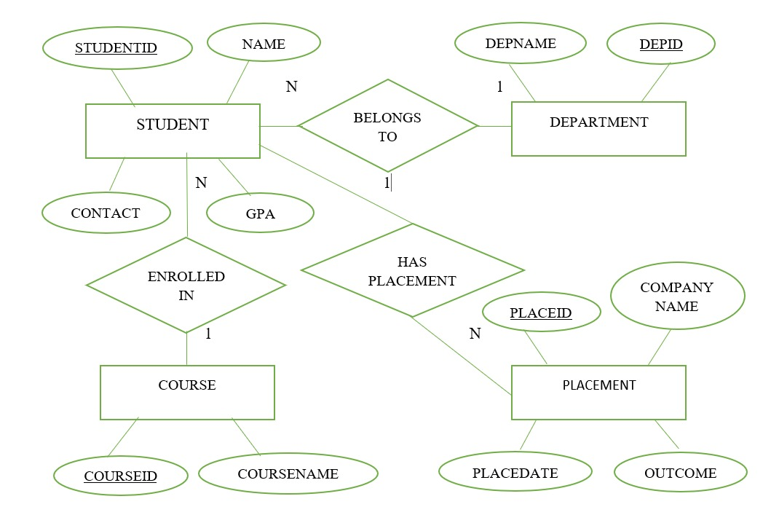
ERD (Entity Relationship Diagram)
Dept. of AIML KNSIT

Slide 10
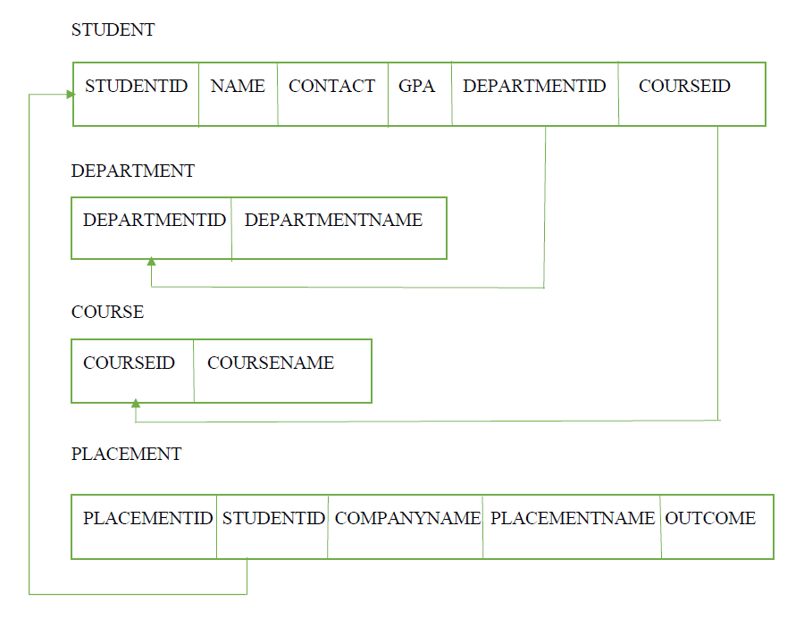
Schema Diagram
College Placement Management System
Dept. of AIML KNSIT

Slide 11
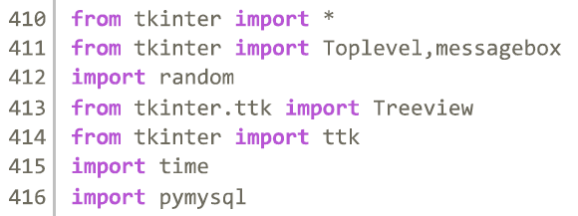
Libraries Used
Dept. of AIML KNSIT

Slide 12
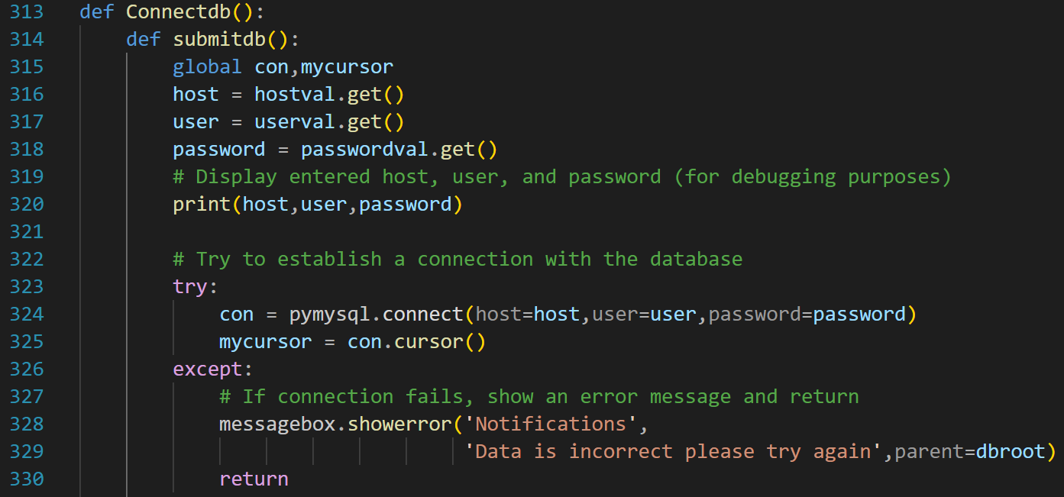
Database Connection
Dept. of AIML KNSIT

Slide 13
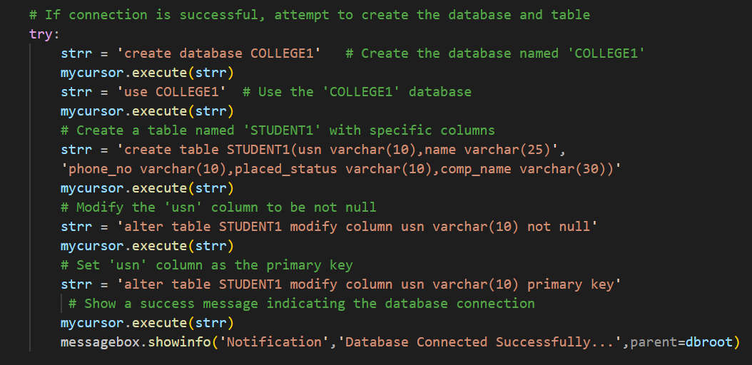
Database Connection
Dept. of AIML KNSIT

Slide 14
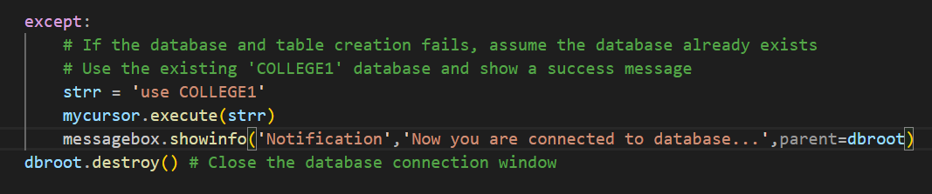
Database Connection
Steps Involved in Connecting Database
Import the Required Modules.
Collect User Input
Attempt Database Connection
Handle Connection Errors
Perform Database
Dept. of AIML KNSIT

Slide 15
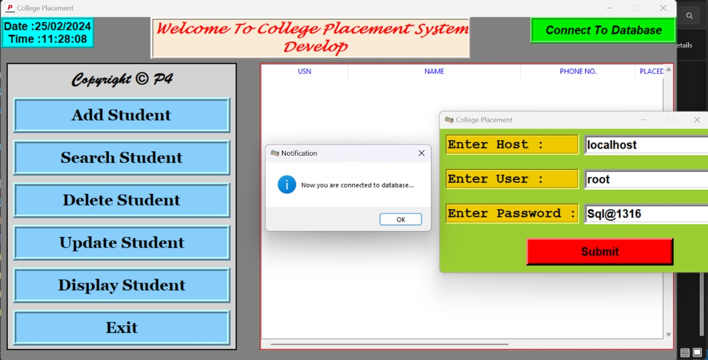
Database Connection
Dept. of AIML KNSIT

Slide 16
Add Student Functionality
Input Collection: Gather student details like USN, name, mobile number, placement status, and company name from user input fields.
Data Validation: Validate user input to ensure correctness and completeness, checking for missing fields or invalid formats.
Database Interaction: Insert the student details into the MySQL database table, handling any potential errors during the process.
Confirmation Message: Display a confirmation message upon successful addition of the student record, allowing users to clear input fields for further additions.
Error Handling: Implement error handling to manage exceptions gracefully, providing informative messages to users in case of errors during the addition process.
Dept. of AIML KNSIT

Slide 17
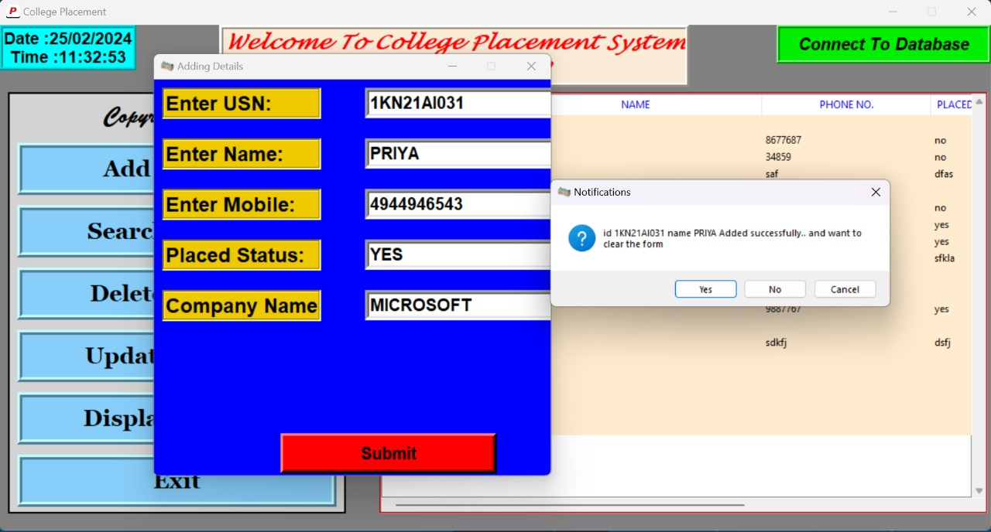
Add Student Functionality
Dept. of AIML KNSIT

Slide 18
Search Student Functionality
Input Collection: Gather search criteria such as USN, name, mobile number, placement status, or company name from user input fields.
Query Execution: Execute SQL queries based on the provided search criteria to retrieve relevant student records from the database.
Display Results: Display the retrieved student records in a table or list format within the GUI, allowing users to view relevant information.
Error Handling: Implement error handling to manage cases where no matching records are found or if there are any issues with executing the search query. Provide appropriate feedback to the user in such scenarios.
Dept. of AIML KNSIT

Slide 19
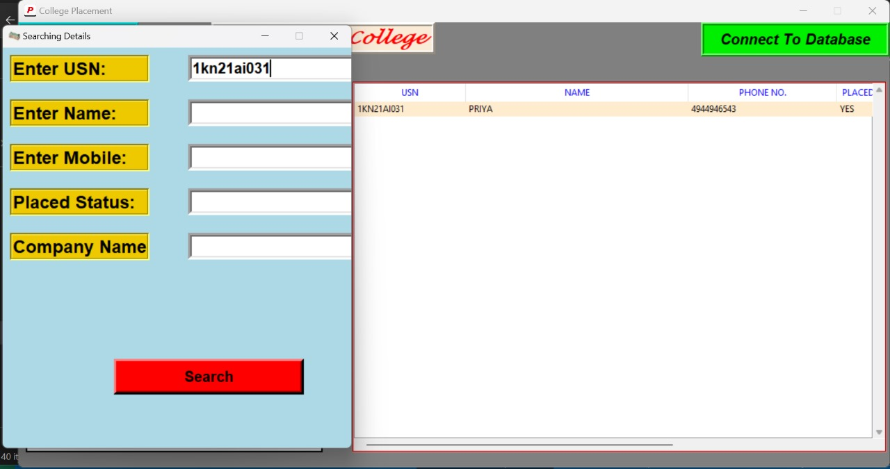
Search Student Functionality
Dept. of AIML KNSIT

Slide 20
Delete Student Functionality
Selection: Allow users to select the student record they want to delete, typically by clicking on the record in a table or list displayed in the GUI.
Confirmation: Prompt the user to confirm the deletion action to prevent accidental deletions of student records.
Database Interaction: Connect to the MySQL database and delete the selected student record from the appropriate table, handling any potential errors during the deletion process.
Update GUI: Update the graphical user interface to reflect the removal of the deleted student record from the displayed table or list, ensuring that the interface remains up-to-date and responsive.
Dept. of AIML KNSIT

Slide 21
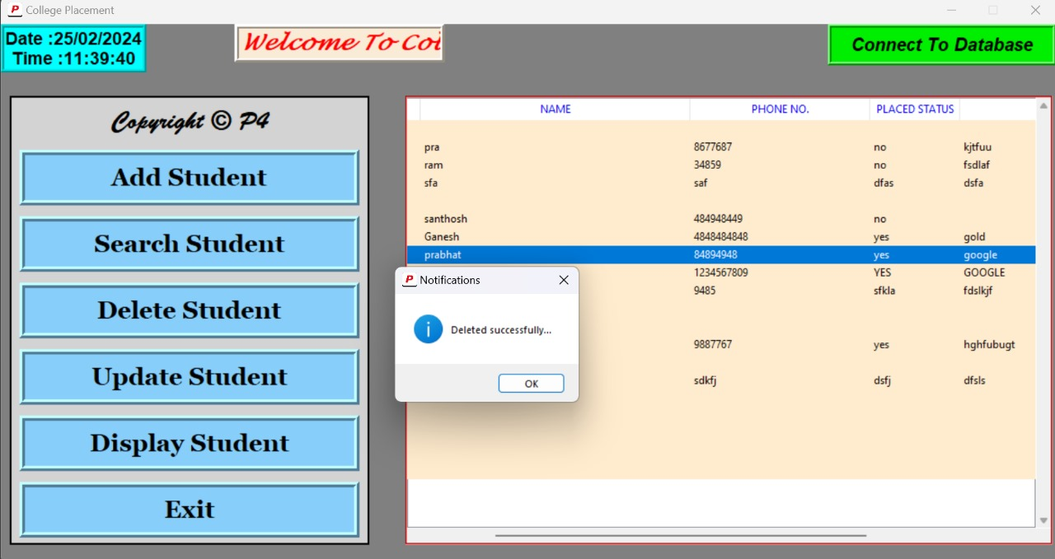
Delete Student Functionality
Dept. of AIML KNSIT

Slide 22
Update Student Functionality
User Input Retrieval: The update functionality retrieves user input for the student's USN (University Serial Number), name, phone number, placed status, and company name from GUI elements like Entry widgets.
Database Update Query: Upon user submission, the code constructs and executes an SQL query to update the corresponding student record in the database with the new information provided by the user.
Feedback to User: Informative messagebox notifications are displayed to the user to indicate the success or failure of the update operation, providing feedback on the status of the update process.
Refreshing Display: After successfully updating the database record, the code refreshes the display to reflect the updated information in the GUI table, ensuring consistency between the database and the application interface.
Dept. of AIML KNSIT

Slide 23
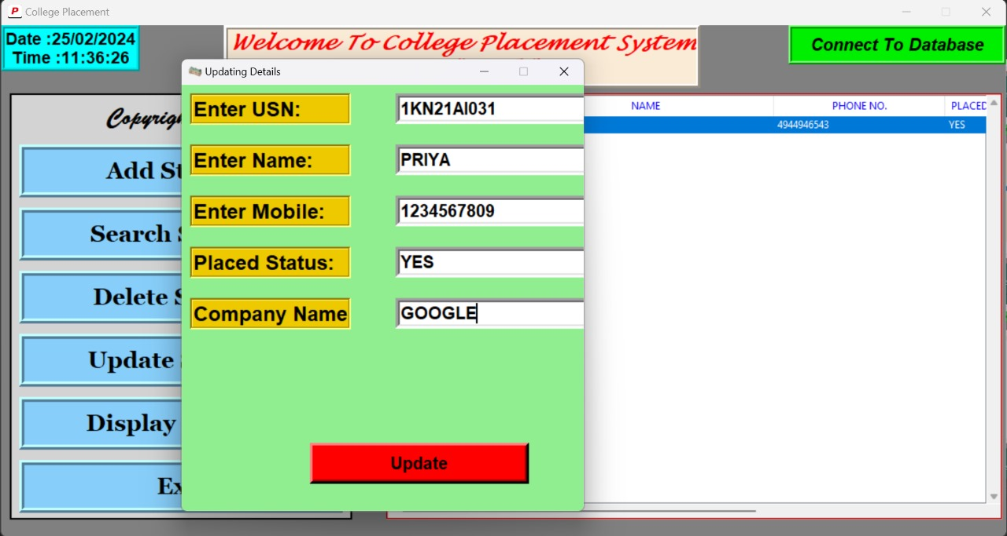
Update Student Functionality
Dept. of AIML KNSIT

Slide 24
Display Student Functionality
Database Query: Retrieve student records from the MySQL database table containing student information.
Data Presentation: Format the retrieved data appropriately for display, ensuring clarity and readability.
Update GUI: Populate the graphical user interface (GUI) with the fetched student records, such as displaying them in a table or list.
Error Handling: Implement error handling to manage situations where data retrieval fails or encounters errors, providing informative messages to users.
Dept. of AIML KNSIT

Slide 25
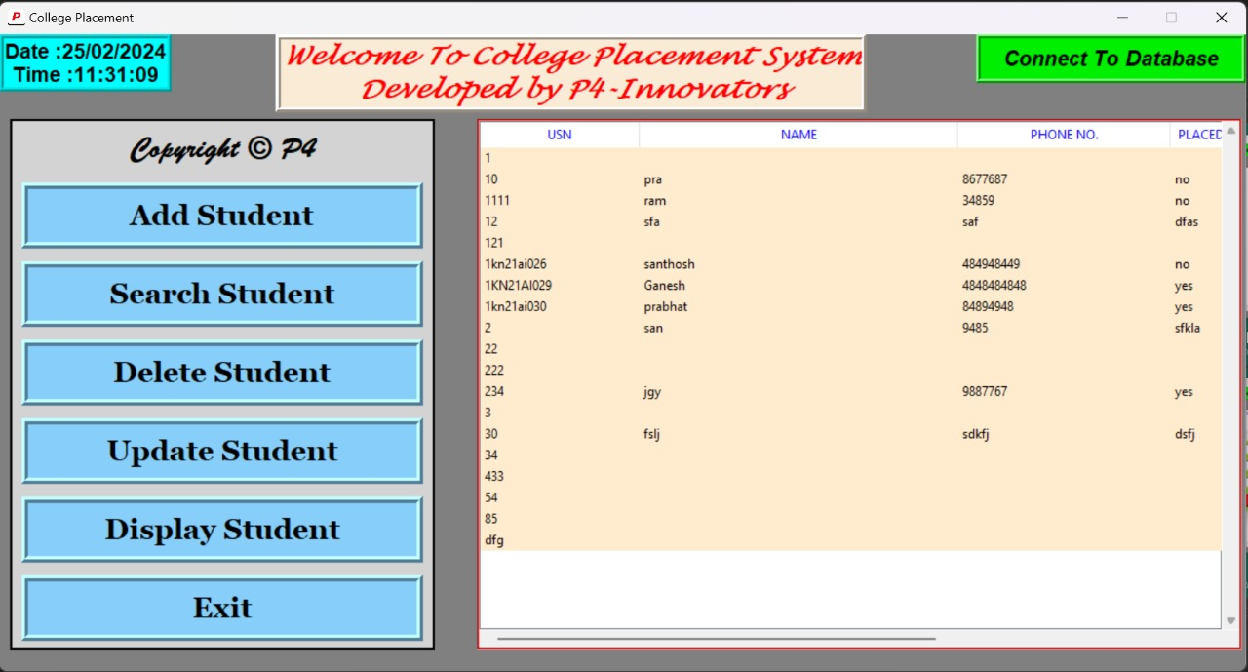
Display Student Functionality
Dept. of AIML KNSIT

Slide 26
Exit Student Functionality
Confirmation Prompt: Display a confirmation prompt to the user asking if they want to exit the application.
User Response Handling: Capture the user's response from the prompt and proceed accordingly based on their choice.
Graceful Exit: If the user chooses to exit, close the application window or terminate the program in a graceful manner.
Data Saving (Optional): Optionally, save any unsaved data or perform necessary cleanup tasks before exiting the application.
Dept. of AIML KNSIT

Slide 27
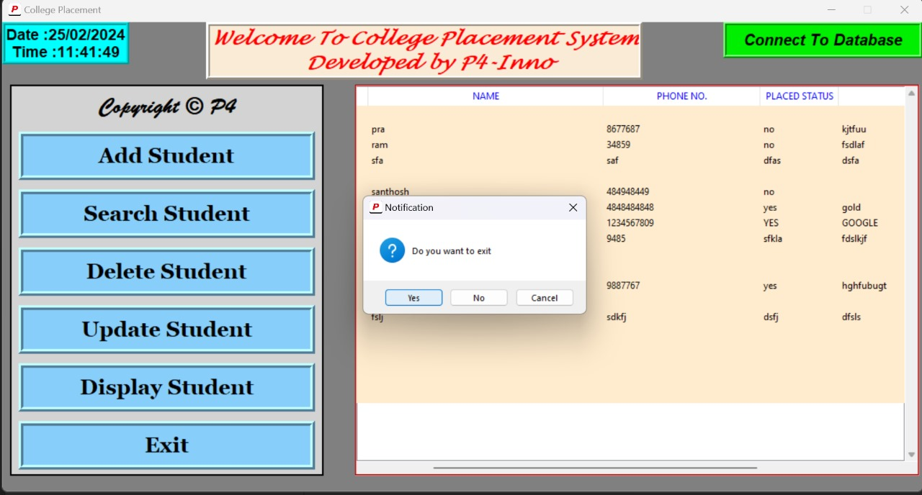
Exit Student Functionality
Dept. of AIML KNSIT

Slide 28
Conclusion
In conclusion, the provided code implements a College Placement System with a graphical user interface (GUI) using Tkinter in Python.
It allows users to perform various operations, including adding, searching, updating, and deleting student records.
The system maintains a connection to a MySQL database to store and retrieve student information.
The GUI features interactive frames for data entry and display, while dynamic components like a slider and clock enhance the user experience.
The code demonstrates proficiency in integrating GUI elements, database operations, and error handling to create a functional college placement application.
Dept. of AIML KNSIT

Slide 29
References
[1] https://www.python.org/doc/essays/blurb/
[2] https://docs.python.org/3/library/tkinter.html
[3] https://realpython.com/python-gui-tkinter/
[4] https://chat.openai.com/
[5] [Smith, J., et al., 2020. "Efficiency and Challenges in College Placement Systems." Journal of Educational Technology, 12(3), 123-145.]
[6] [Garcia, L., et al., 2015. "Challenges in College Placement Management: A Case Study Approach." Educational Technology Research and Development, 18(4), 321-340.]
[7] [Clark, E., et al., 2021. "Future Trends in College Placement Management: A Technological Perspective." Journal of Educational Technology Trends, 14(3), 189-210.]
[8] https://www.youtube.com/playlist?list=PLS4zv4KDAagNMuRjHjJKn30CZZTlHzkTV
Dept. of AIML KNSIT

Slide 30
THANK YOU

